Slide 1
Tech Leadership Challenge
Women: Keep them, culture to harness strengths, and promoting into leadership ranks.

Slide 2
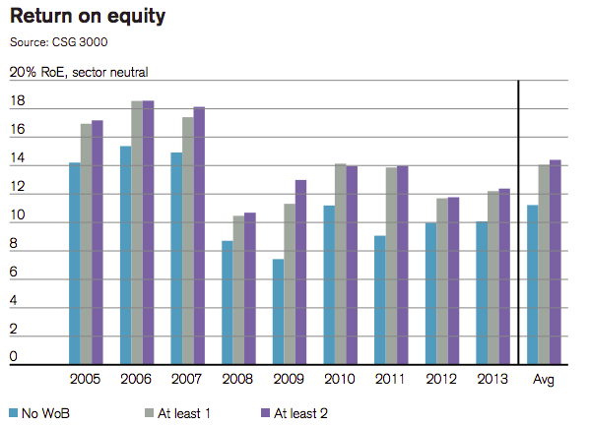
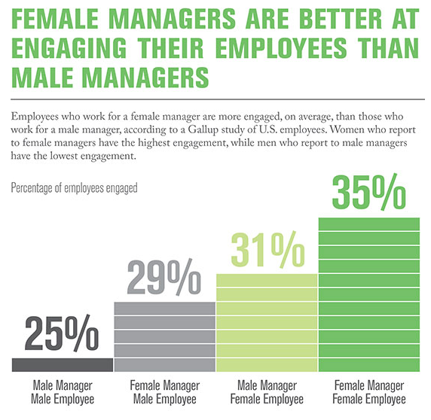
Why Tech Needs More Women
Companies & Teams Perform Better.
80% of Purchasing Decisions in US are made by Women

Slide 3
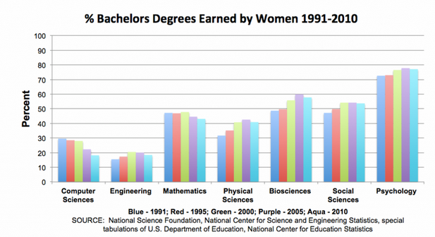
Is this really a “pipeline” problem?
Yes
And
NO
47% of Women in Science… Leave
39% of Women in Engineering… Leave
56% of Women in Technology… Leave

Slide 4
Culture
Gender Intelligence
Focus
Promotion
Management / Executive Leadership
System for Balance

Slide 5
What is Culture?
Culture
Demonstration
Purpose
Translation
Language
Behavior
Meaning
Relationships
Demonstration
Values
Translation

Slide 6
New Conversation
Gender Intelligence
Acknowledge Differences
Actions
Nature
Business Case
Nurture
Leadership Commitment
Systemic
Powerful & Influential Coalition
Enterprise Wide Resolve

Slide 7
Strategic Imperative
Focus
Recruiting New Grads
Recruiting Top Professionals
Establish Key Metrics – Tie to Gender Intelligence Efforts
Advancing Gender Intelligent Leaders
Measure Business Performance
Improved Performance
Today…

Slide 8
Mentors & Patrons
Promote
Technical
Management
Executive
Technical Leadership

Slide 9
One is Not Enough
Management & Executive Leadership
Technical Leadership
Principles
Management
Functional Teams
Executive Leadership
Directors
Publish
Speaking
Program Management
VP
C-suite

Slide 10
Infrastructure & Leading by Example
System for Balance
Integrated Lives
Flexible
Policies
Human Resource
Wellness
Movement
Family & Social Time
Used & Supported
Sleep
Nutrition
Etc.

Slide 11
Culture
Gender Intelligence
Focus
Promotion
Management / Executive Leadership
System for Balance
Challenge!

Slide 12
Sources
http://thinkprogress.org/economy/2014/09/25/3572355/women-on-boards-performance/
http://www.pbs.org/newshour/making-sense/truth-women-stem-careers/
http://www.gallup.com/businessjournal/178355/having-women-leaders-good-business.aspx
http://www.ncwit.org/sites/default/files/legacy/pdf/NCWIT_TheFacts_rev2010.pdf

Slide 13
Tina dao
Director Product Engineering
Fitbit, INC.
Tina is currently the Director of Product Engineering at Fitbit where she is creating a team from the ground up. She is known for creating shared vision, developing strategy and putting mechanisms in place to achieve operational excellence; she is most recognized for her ability to create a culture that fosters innovation, collaboration, and customer focus.
Tina’s personal passion includes gender equality and bringing thought diversity to the world of business and leadership in general. She is continuously learning and loves to facilitate the learning of others; she has even been an adjunct faculty member at a university for MBA students.

